Slide 1

Liberty Life Assurance Co. of Boston
Peter Buechler AAPA, ACS
Manager, Annuity Marketing
CPS Insurance Services
For Rep Use Only

Slide 2

Innovation IN
ASSET TRANSFER
For Rep Use Only
Notes:
A wealth transfer tool
prospects have deferred annuities that they don’t intend to use for their retirement but intend to leave to their beneficiaries.
The target market is approximately 70 years old and generally

Slide 3

The Problem:
Deferred Annuities at Death
For Rep Use Only

Slide 4
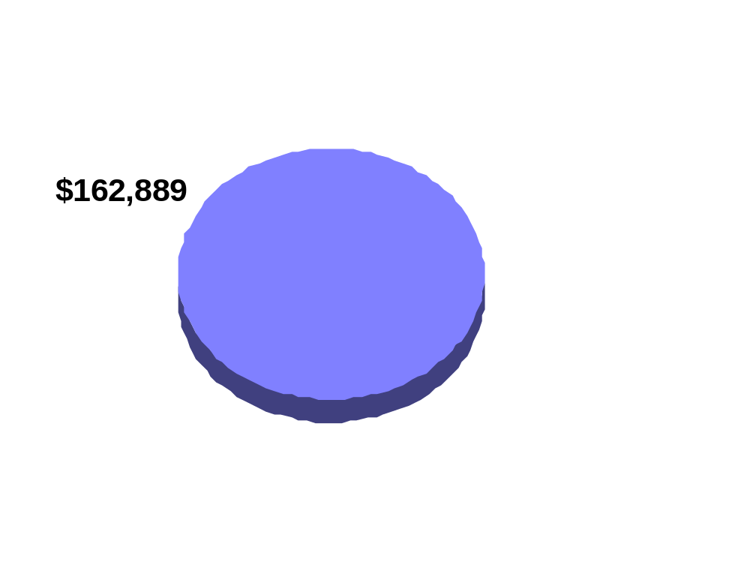
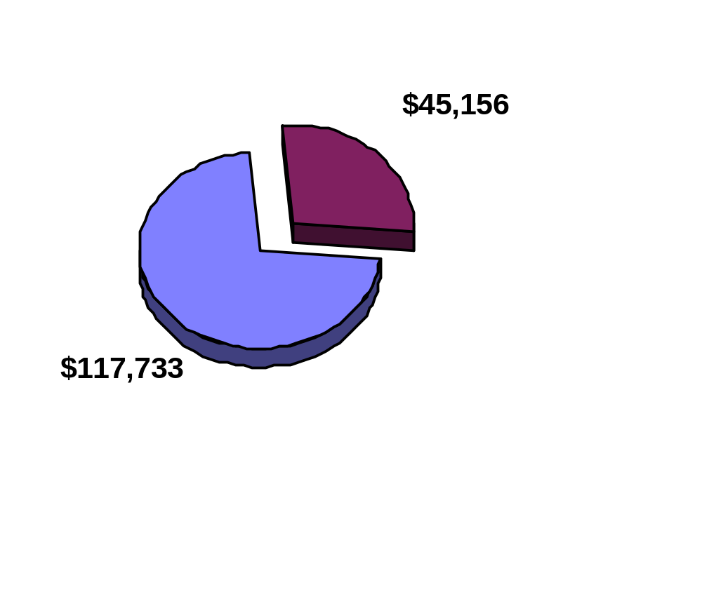
Taxes Due at Death
Assumptions:
Basis = $50,000
Beneficiary Tax Rate = 40%
For Rep Use Only

Slide 5
What Else Can You
Do With the Money?
For Rep Use Only

Slide 6
The Unique Advantages of Life Insurance
Death benefit greater than the sum of premiums paid
Death benefit income tax-free
Easy access to cash features
For Rep Use Only

Slide 7

The Legacy Link Difference
$117,733 from annuity inheritance.
Amount beneficiaries could receive after federal income taxes.
$146,595 from Legacy Link.
Death benefit beneficiaries could receive with no income taxes due.
The annuity inheritance in the examples above assumes a current annuity value of $100,000 with a basis of $50,000. Interest is compounded at 5% over 10 years and would be assessed income taxes at the beneficiary’s assumed rate of 40%. The numbers are for illustration purposes only and do not represent the actual or projected growth of any particular annuity. The Legacy Link inheritance is based on the purchase of Personal Choice Plus, a flexible premium adjustable life insurance policy, with an 8 year pay-in of $11,700.33 each year from the $100,000 annuity. Premiums equal the annuity payments net of income taxes at the annuity owner’s assumed rate of 30% , and the death benefit is based on a 65-year-old female issued Standard using guaranteed rates and assumptions.
For Rep Use Only

Slide 8
SPIA to Life Insurance
A seamless transfer of money
For Rep Use Only

Slide 9
Why not use SPWL?
Why 8, 9, or 10 payments?
For Rep Use Only

Slide 10
Additional Benefits
  Accelerated Death Benefit
  90% of DB payable while living
  Terminal Illness (12 Mos <)
  Nursing Home- 6 Mos confinement in skilled NH &will not leave for life/2 of 6 ADL’s
For Rep Use Only

Slide 11
Underwriting
Non-invasive underwriting- age 75 or <, face 150K or <
15 Minute Instant approval
Full underwriting for older ages/higher face amounts
Standard=4 tables built in or multiple tables for less than std health
For Rep Use Only

Slide 12
Is there really a market?
1997 deferred annuity sales topped $120 Bill.
More than 1/2 of non-qual ann. buyers are 65+
88% of Annuities sold between ‘79 -’93 are untouched
Source: LIMRA
For Rep Use Only

Slide 13
Fact Finding - Key Questions:
  When do you plan on annuitizing your annuity ?
  Are you taking systematic payments from your annuity ?
  Who is your beneficiary?
  Why?
  Tell me about your beneficiary.
  LISTEN TO YOUR CLIENTS
For Rep Use Only

Slide 14
Responses to Common Client Concerns:
What if I need the money?
What if I get sick?
What if I go into a Nursing Home?
What about income taxes?
For Rep Use Only

Slide 15
Summary
Client with annuity contract they will not use for income- Tax Time Bomb to heirs
15 Minute approval process
1035 old annuity into Legacy Link
SPIA in Legacy Link funds 8-10 pay UL (Tax paid by Liberty or out of pocket)
Heirs have Income Tax Free Death Benefit at Death
Seamless transfer of assets to client
For Rep Use Only

Slide 16
Compensation
  8% Clients age 65 and older
  6% Clients under age 65
For Rep Use Only

Slide 17
Estate Maximizer Single Premium Whole Life (SPWL)
Alternative Transfer contract for non-annuity sums of money
Single Payment Purchase
Income Tax Free Death Benefit
Avoids Probate - Paid to named beneficiary
15 Minute Jet Underwriting
Accelerated Death Benefit - 90% of DB if terminally Ill or confinement to a nursing home for 6 months and unable to perform 2 of 6 ADL’s
For Rep Use Only

Slide 18
Further Information contact:
CPS ANNUITIES
Ph-(800)326-5433 ext 148 or 143
Website-www.cpsinsurance.com
Email-
annuity@cpsinsurance.com
For Rep Use Only

Slide 19
www.CPSInsurance.com
  Additional Legacy Link / Estate Max Info
  General Product info; Rates, State Availability
  34 Compliance approve client handouts
  24 Broker focused training handouts
  Lic/Contracting & Application Forms
  Real time case status
  Carrier strength ratings info - Vital Signs
  Web Training
For Rep Use Only

Slide 20
Did You Know?
Has been in business for 29 years
Is contracted with over 50 highly rated carriers
National Wholesaler licensed in all 50 states
Is the LARGEST independently owned insurance wholesaler in the nation
Has 2 in-house underwriters
Has an in-house Tax & Estate Planning Attorney for advanced concepts- Buy-Sell, 412i etc.
Has full service Life, LTC and Annuity departments
For Rep Use Only

